Slide 1
Development of an SRAD Flight Computer
UB Students for the Exploration and Development of Space

Slide 2
Flight Computer Requirements
Track and record flight telemetry
Deploy recovery system
Reliable GPS tracking
Record video (Optional)

Slide 3
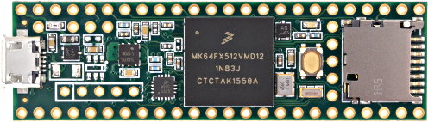
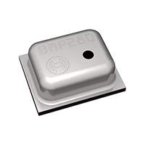
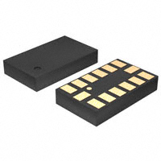
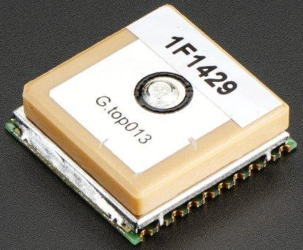
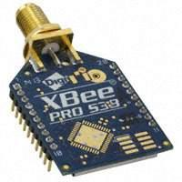
Component Selection
Teensy 3.5: Speed, space, SD card, Arduino compatibility
BMP280: Fast, easy to use
ADXL345: Fast, easy to use
MTK3339: Easy to use, ext. ant. capability
XBee-PRO 900HP: Proven component

Slide 4
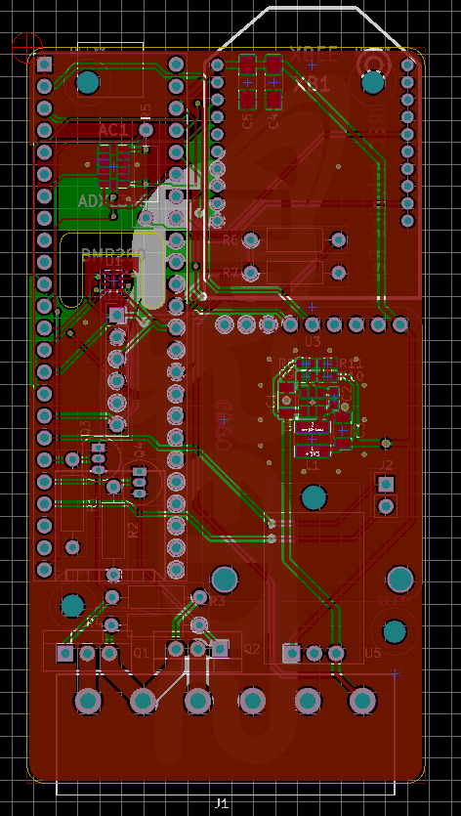
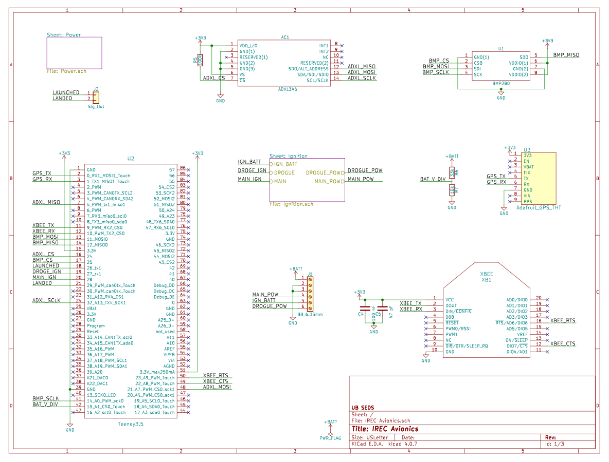
PCB Design
Reusable modules
Separate ignition battery

Slide 5
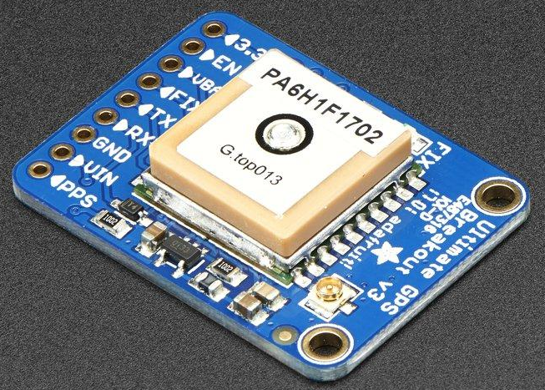
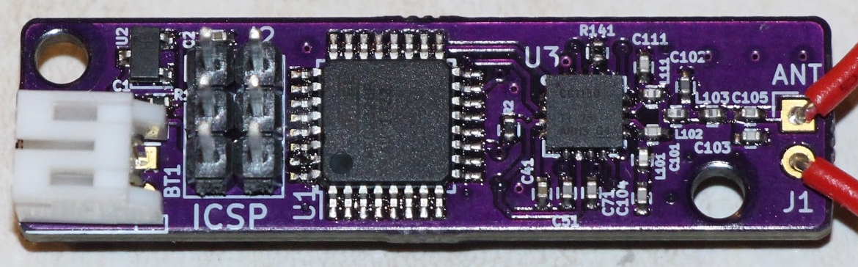
Tracking
GPS for precise positioning, simple RDF backup for bad signal conditions
Custom RDF transmitter with 40 hour battery life
Redundancy:
Primary flight computer with GPS tracking
COTS GPS tracker
Main section SRAD RDF tracker
Tail section SRAD RDF tracker

Slide 6
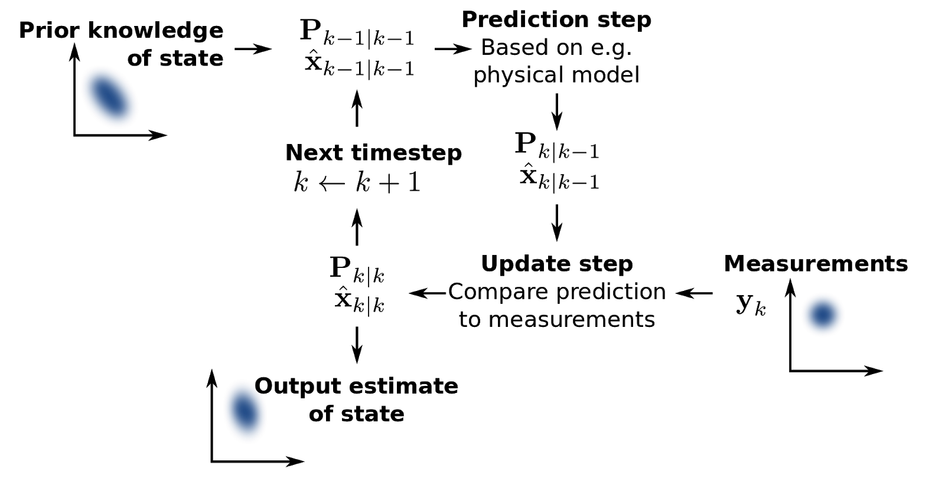
Kalman Filter For Apogee Detection
Combines Senor measurements with theoretical system dynamics
Pros
Improved state estimation
Sensor fusion
Cons
Added complexity
Kalman filters are linear, rocket dynamics are inherently nonlinear.
https://en.wikipedia.org/wiki/Kalman_filter

Slide 7
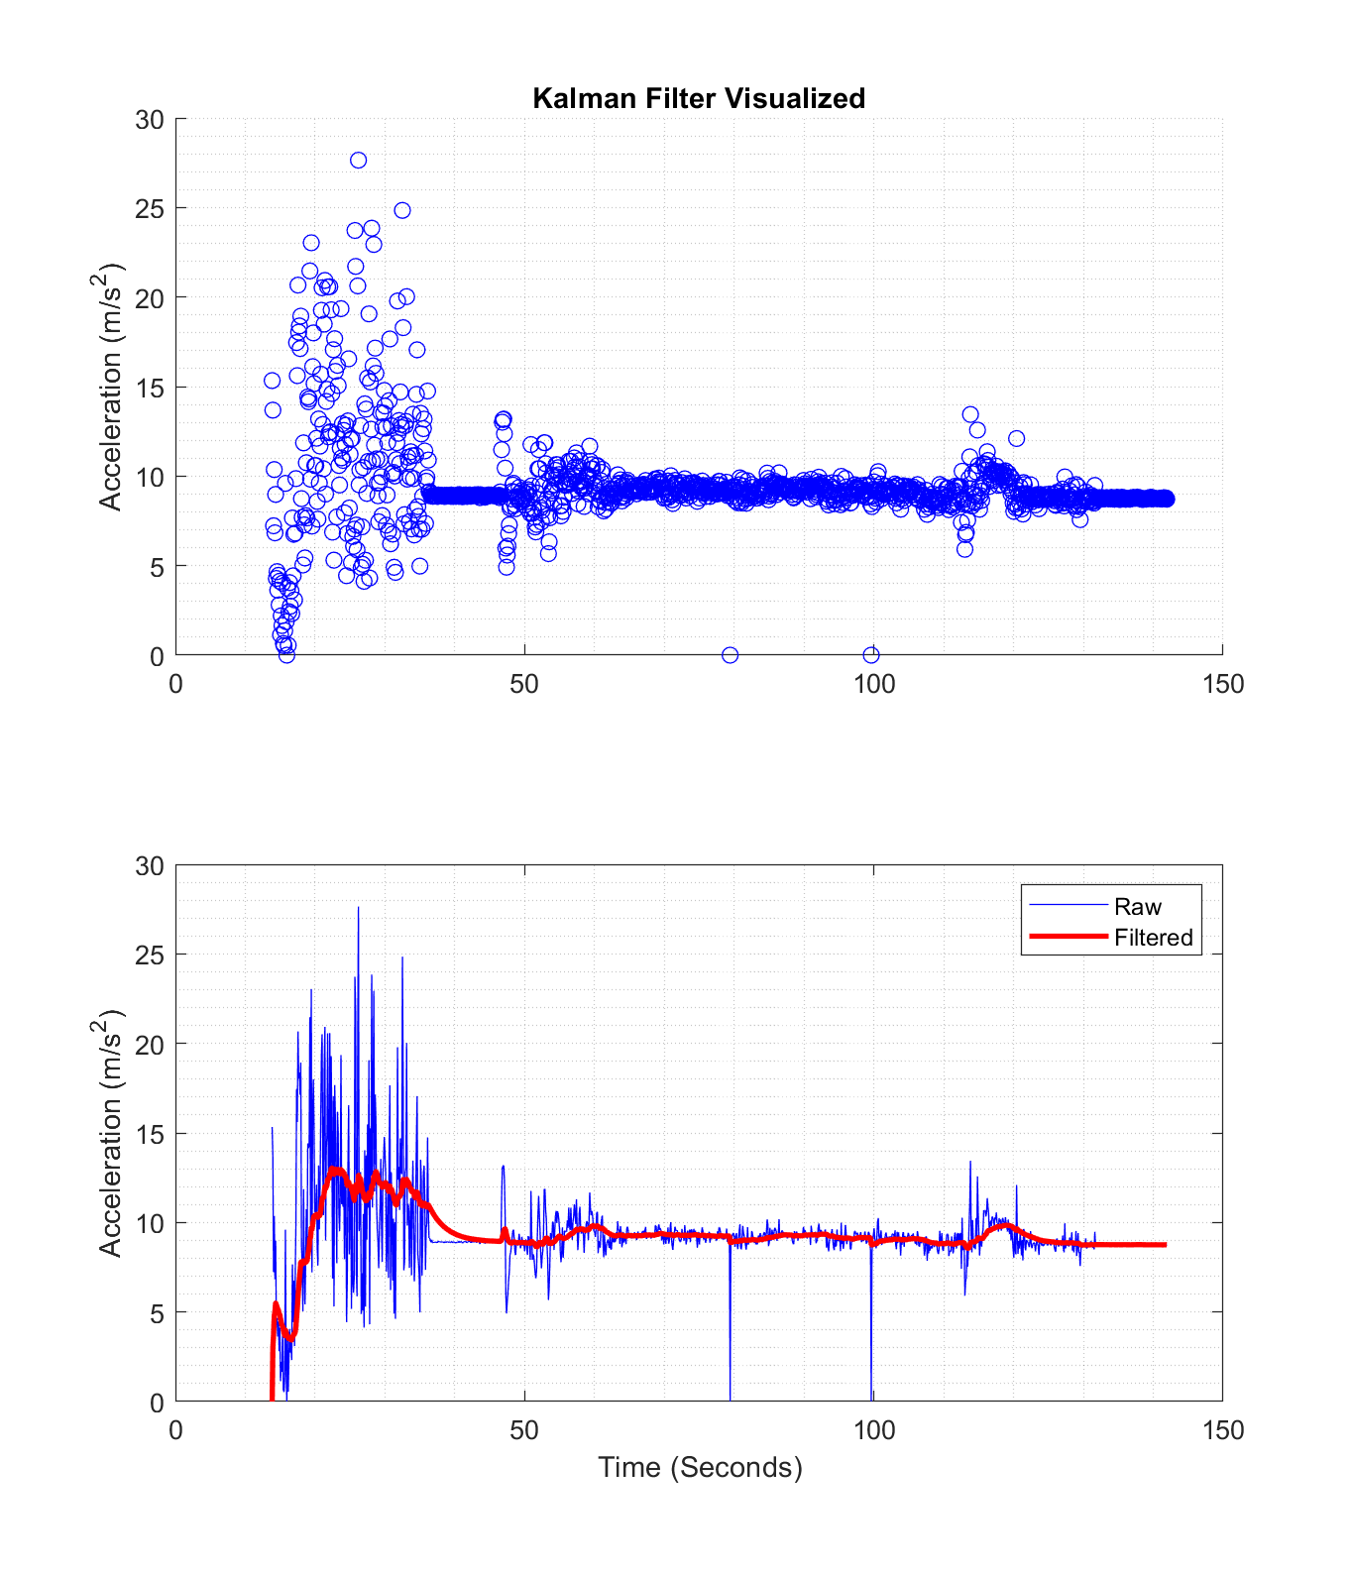
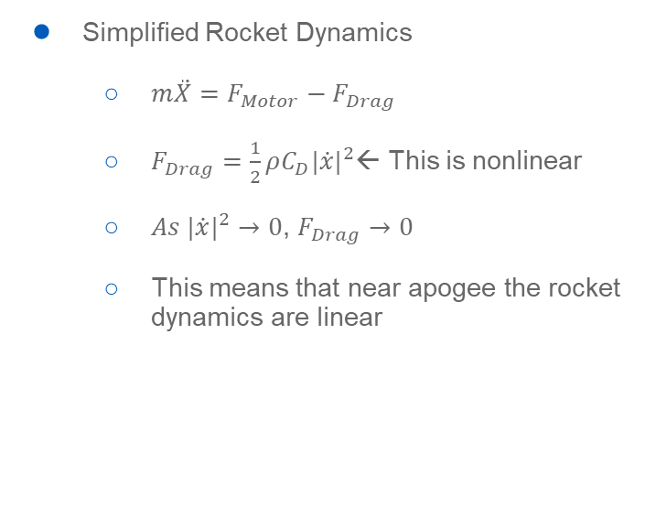
Kalman Filter (Part 2)
Simplified Rocket Dynamics
$m\ddot{X}=F_{Motor}−F_{Drag}$
$F_{Drag}=\frac{1}{2}ρC_{D}{|\dot{x}|}^{2}$← This is nonlinear
$As {|\dot{x}|}^{2}→0$, $F_{Drag}→0$
This means that near apogee the rocket dynamics are linear

Slide 8
Testing
Attached to custom built high-thrust quadcopter for quasi-ballistic launch simulation.
Test 1
Late apogee detection observed.
Kalman filter calibration corrected.
Test 2
Unreliable operation.
Faulty accelerometer replaced.
Test 3
Accurate and reliable apogee detection observed.

Slide 9
Conclusion
Working flight computer
Kalman filter apogee detection
Data logging
Live telemetry
GPS and RDF tracking
Future design
Optimization
Price, size, power usage, battery requirement, etc.
SRAD radio

